Slide 1
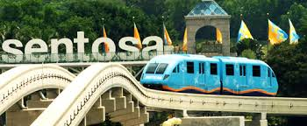
Sentosa
09_Leemsejin_1E3

Slide 2
Immerse Yourself In Seven Zones
Butterfly Park & Insect Kingdom
Sentosa Nature Discovery
Tiger Sky Tower
Sentosa 4D Adventure park
Singapore Cable Car

Slide 3
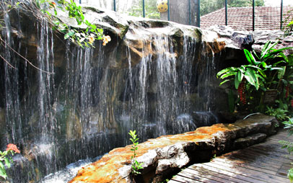
Butterfly Park & Insect Kingdom
Surrounded with lush tropical greenery, Butterfly Park & Insect Kingdom showcases the stunning beauties of mother nature. With a great variety of fluttering butterflies and exotic insects, this tamed wilderness is sure to delight you.

Slide 4
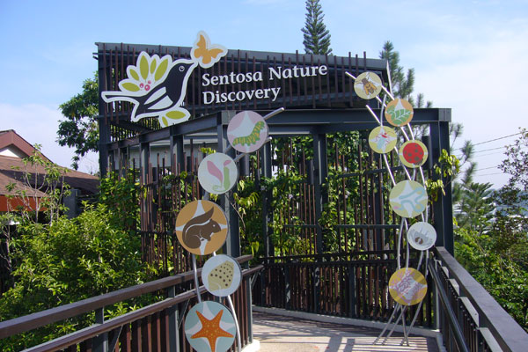
Sentosa Nature Discovery
Embark on a hands-on journey of discovery and sharpen your detective skills. At Sentosa Nature Discovery, nature and fun go hand-in-hand

Slide 5
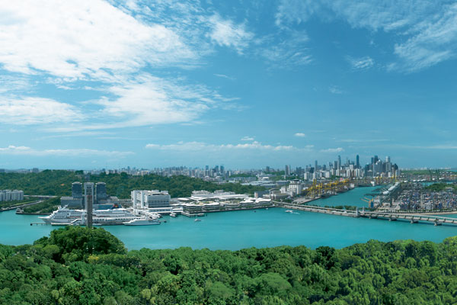
Tiger Sky Tower
Gently rising 131 metres above sea level, relax inside the air-conditioned cabin of the Tiger Sky Tower and enjoy panoramic views across Sentosa and Singapore's Southern Islands – as well as neighbouring Malaysia and even Indonesia.

Slide 6
Sentosa 4D Adventure park
Home to UNLIMITED FUN! Go on in an immersive 4-D movie, NEW: Journey 2: The Mysterious Island, The 4-D Experience. Next, Hang On Tight as you ride on a virtual 4-D roller coaster “Extreme Log Ride” and Grab a motion-sensor pistol, aim and fire at Asia’s first 4-D Interactive Shoot-Out game happening at “Desperados”.

Slide 7
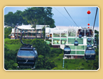
Singapore Cable Car
Be captivated and enthralled by the setting sun as the night unfolds a picturesque Singapore landscape with Singapore Cable Car offering a stunning 360-degree view of the Southern precinct with its transparent enclosure.

Slide 8
Click HERE to go to the Offical Website

